Slide 1
ANTICOAGULANTS AND THROMBOLYTIC AGENTS

Slide 2
I-Anticoagulants:
1-HEPARIN.
2-Oral anticoagulants.
3-Antithrombin

Slide 3
Low molecular weight heparin
Synthetic pentasaccharide inhibitors of factor Xa
Fondaparinux is a synthetic sugar composed of the five sugars (pentasaccharide) in heparin that bind to antithrombin. It is a smaller molecule than low molecular weight heparin.
Idraparinux
Heparin and derivative substances

Slide 4
1-Heparin
is a naturally occurring glycosaminoglycan, that has immediate action after its administration (subcutaneous or I.V).
Mech. of action:
Bind with antithrombin III (At III) , potentiating its inhibitory action on thrombin , XIIa, XIa and Xa.

Slide 5
Types:
1-Ordinary heparin ( mol. weight 15000-18000)
2-Low molecular weight heparin (mol weight =5000) , it has a longer half life than ordinary heparin

Slide 6
Low molecular weight heparin is a more highly processed product that is useful as it does not require monitoring of the APTT coagulation parameter (it has more predictable plasma levels) and has fewer side effects

Slide 7
Indications:
Acute thrombosis , and thrombosis in pregnancy
Prophylaxis of thrombosis in pregnancy and in high risk surgery

Slide 8
Dose:
S.c. 5000 u/ 8-12 h or 2000 u of low MW
Continuous I.V. : 1000 u / 6 hours
Monitoring:
By A.P.T.T.: keep it 1.5 -2.5 times that of the control plasma

Slide 9
Toxicity:
Bleeding
Osteoperosis
Thromocytopenia
Treatment of overdose:
By protamine sulphate (1 mg IV neutralize 100 u heparin)

Slide 10
2-Oral anticoagulant therapy:
Ex. Warfarin
Action: takes 48 – 72 hours for full action
Interfere with the action of vitamin k in the hepatic synthesis of factors II, VII, IX and X
Inhibit action of protein C and S
Monitoring of its action:
By PT (prothrombin time) and INR

Slide 11
Indications:
Treatment of deep vein thrombosis (DVT) and pulmonary embolism (INR 2-3)
Prophylaxis of DVT in high risk surgery (INR- 2-2.5)
Recurrent DVT (INR 3-4.5)
A.F (INR 3-4.5)
Myocardial infraction (INR 3-4.5)
Prosthetic valves and grafts (INR 3-4.5)

Slide 12
Contraindications:
Pregnancy
Peptic ulcer
Severe hypertension
Infective endocarditis
Renal damage
Hepatic diseases

Slide 13
Drug interactions:
Potentiation of its action : oral hypoglycemic drugs, aspirin, NSAID , penicillin and alcohol
Reduction of its action : spironoloctone, barbiturates and oral contraceptive drugs

Slide 14
3-Direct thrombin inhibitors:
Another type of anticoagulant is the direct thrombin inhibitor. Current members of this class include argatroban, lepirudin, bivalirudin, and dabigatran.

Slide 15
Anticoagulants outside the body
Laboratory instruments, test tubes, blood transfusion bags, and medical and surgical equipment will get clogged up and become nonoperational if blood is allowed to clot. Chemicals can be added to stop blood clotting. Apart from heparin, most of these chemicals work by binding calcium ions, preventing the coagulation proteins from using them.

Slide 16
EDTA is denoted by mauve or purple caps on Vacutainer brand test tubes. This chemical strongly and irreversibly binds calcium. It is in a powdered form.
Citrate is usually in blue Vacutainer tube. It is in liquid form in the tube and is used for coagulation tests, as well as in blood transfusion bags. It gets rid of the calcium, but not as strongly as EDTA. Correct proportion of this anticoagulant to blood is crucial because of the dilution. It can be in the form of sodium citrate or ACD.
Oxalate has a mechanism similar to that of citrate. It is the anticoagulant used in fluoride (grey top) tubes.

Slide 17
II-Fibrinolytic agents:
Drugs that are able to lyses fresh thrombin

Slide 18
Action:
Direct or indirect activation of plasminogen , with stimulation of fibrinolytic pathway
Lyses of intravascular clots
Lyses of fibrinogen

Slide 19
Uses:
Can be used systemically as in :
Acute pulmonary embolism
Ileofemoral thrombosis
Or locally as in peripheral arterial diseases

Slide 20
Types:
First generation agents e.g., streptokinase and urokinase
Second generation agents:
Tissue plasminogen activators
Single chain uorkinase plasminogen activators
Acylated plasminogen streptokinase activators

Slide 21
Contraindications:
Severe hypertension
Peptic ulcer
Recent streptococcal infection

Slide 22
III-Antiplatelets drugs:
1- Aspirin.
2-Dipyridamole (persantin)
3-Sulphinpyrazone .

Slide 23
1- Aspirin
Action:
In low dose (75 mg/d) irreversibly inhibit the platelet cyclo-oxygenase activity , hense inhibiting the generation of thrombokinase A2 (TXA2) thus inhibiting platelets aggregation and the release reaction of platelets

Slide 24
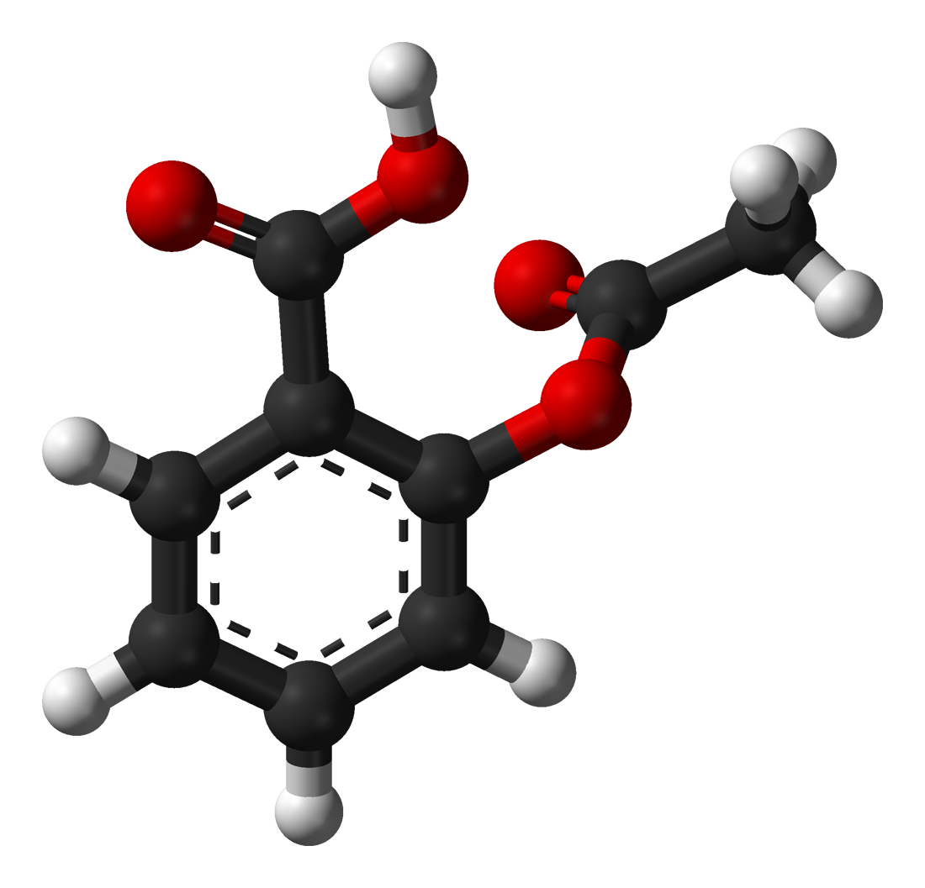

Slide 25
In standard dose it reversibly inhibit the endothelial cell cyclo-oxygenase thus prevent synthesis of prostacyclines which is anti aggregator

Slide 26
Adverse effects:
Gastrointestinal:Aspirin use has been shown to increase the risk of gastrointestinal bleeding
Central effects:tinnitus.
Reye's syndrome: a severe illness characterized by acute encephalopathy and fatty liver, can occur when children or adolescents are given aspirin for a fever or other illnesses or infectionFood and Drug Administration now recommends that aspirin (or aspirin-containing products) should not be given to anyone under the age of 12 who has a fever.

Slide 27
2-Dipyridamole (persantin):
is a phosphodiesterase inhibitor , that increase the level of C-AMP in platelets , it also has a synergistic action with low dose aspirin

Slide 28
3-Sulphinpyrazone
interfere with platelet function by unknown mechanism

