Slide 1
Pathology of Coagulation
I- Deficiency of Coagulation Factors
II-HYPERCOAGULABLE STATES

Slide 2
I- Deficiency of Coagulation Factors

Slide 3
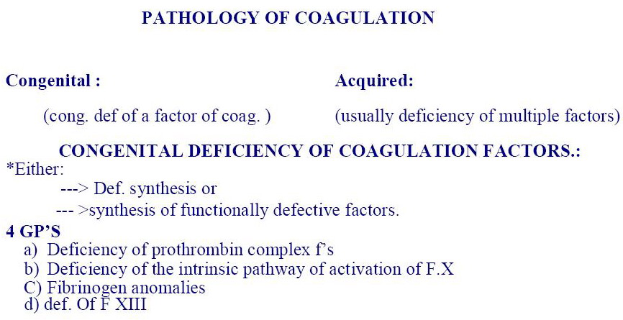

Slide 10
Treatment

Slide 12
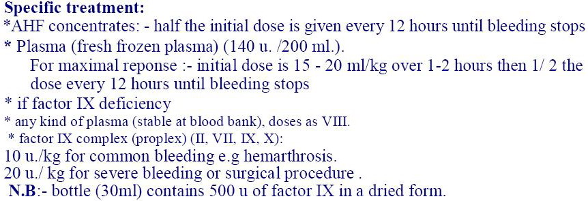

Slide 13
AQUIRED DISORDERS
OF
BLOOD COAGULATION

Slide 16
ACQUIRED DISORDERS
OF
BLOOD COAGULATION

Slide 19
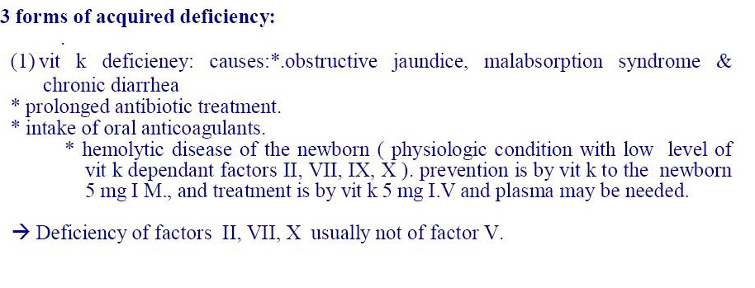

Slide 23
Dissiminated I.V.C

Slide 24
Unexplained profuse or uncontrolled bleeding
In certain surgical & obst. situations.

Slide 25
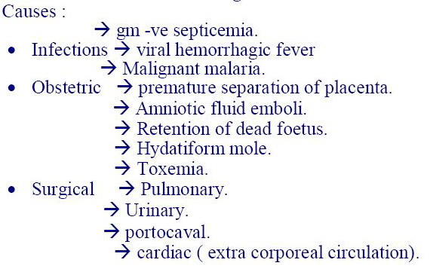

Slide 27
Mechanism
Due to either:
-Vascular lesion (gram –ve septicemia)
or:
-Direct liberation of factors of coagulation (as in other causes)
1→diffuse process with consumption of several coagulattion factors→diffuse bleeding
2→formation of microthrombi→vascular occlusion.

Slide 28
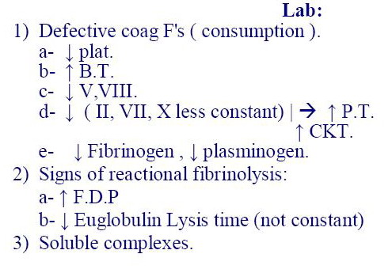

Slide 29
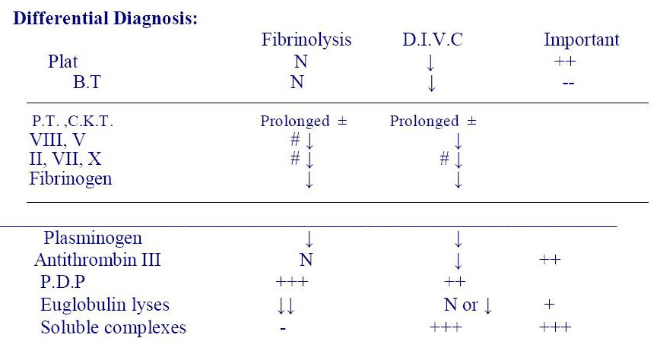

Slide 30
The main haemostatic abnormalities 0f DIVC are reflected by: prolonged TT, hypofibrinogenemia and thrombocytopenia. A fibrinogen level below 1g/L (N 1.5-4g/L),platelet count below 100.000 and TT >double control is diagnostic.

Slide 33
fibrinolysis (Hyperfibrinolysis),
acquired disturbance of fibrinolysis (Hyperfibrinolysis), is not uncommon. Many trauma patients suffer from an overwhelming activation of tissue factor and thus massive hyperfibrinolysis.^{[6]} Also in other disease states hyperfibrinolysis may occur. It could lead to massive bleeding if not diagnosed and treated early enough.
The fibrinolytic system is closely linked to control of inflammation, and plays a role in disease states associated with inflammation. Plasmin, in addition to lysing fibrin clots, also cleaves the complement system component C3, and fibrin degradation products have some vascular permeability inducing effects

Slide 34
Reports of Hemostasis:-
vit K deficiency:
-------------------------
Platelet ---> N.
B.T ---> N.
Q.T --->(30"/ 14) --->40%
C.KT ---> 95/65
Fibrinogen ---> 2,3g / L
T.T ---> 8" /18"
Factors: -- VII + X ---> 25%
V --->100%
II ---> 40%
AHF's ---> VIII --> 100%
IX --> 40%

Slide 35
Acute Hepatitis:
----------------------
Platelet ---> N
B.T ---> N
Q.T ---> 22"/ 14"
CKT ---> 92/65"
Fibrinogen ---> 2g /L
T.T --->20 / 18 sec
Euglobulin lysis time >3 hours.
Factors. VII + X ---> 35%
V 60%
II 65%

Slide 36
Decompensated Cirrhosis:
------------------------------------
Platelet --->N or slightly ↓
B.T ---> N
Q.T ---> 24/14'
CKT ---> 80/ 65"
fibrinogen 1,9 gm.
T.T 32/ 18 Sec.
Euglobulin lysis time = 45'
control > 3 hours.
Factors ---> VII+ X 30%
V 25%
II 40%

Slide 37
II-HYPERCOAGULABLE STATES
Conditions associated with clinical and laboratory evidences of increased risk for developing thromboembolic complications as:
Deep vein thrombosis (DVT)
Pulmonary embolism
Recurrent thrombosis of unknown cause

Slide 38
Causes:
1-Hereditary (thrombophilia) .
2-Acquired .

Slide 39
1-Hereditary (thrombophilia) :
recurrent familial + thrombotic complications due to genetic defects associated with the physiological anticoagulant mechanisms e.g:
Antithrombin III deficiency or of low functional level
Protein C deficiency
Protein S deficiency
Fibrinolytic system defects
Dysfibrinogenemia
Unknown causes

Slide 40
The effect of genetic risk factors increases with age

Slide 41
II-Acquried :
1-May complicate surgery and many disorders like: malignancy , pregnancy, use of oral contraceptive, obesity,diabetes,hyerliedemia or homocytostinuria.

Slide 42
2-Antiphospholipid syndrome: acquired autoimmune disorder in which there is autoantibodies against phospholipids protein complexes, it may complicate LE,antibiotics, phenothiazine and viral infections, this autoantibodies may interferes with coagulation or it may induce thromboembolic complications

