Slide 1
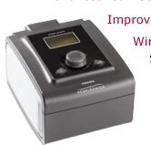
Bi-PAP AVAPS
By
Nesreen El-Sayed Morsy Aly
Assistant lecturer
Thoracic Medicine Department
Mansoura University

Slide 2


Slide 3
Bi-PAP AVAPS
Bi level positive airway pressure
Average Volume Assured Pressure Support

Slide 4

Principle
.

Slide 5
It's the only way of ensuring the delivery of targeted tidal volume for non invasive ventilation patients.
.

Slide 6
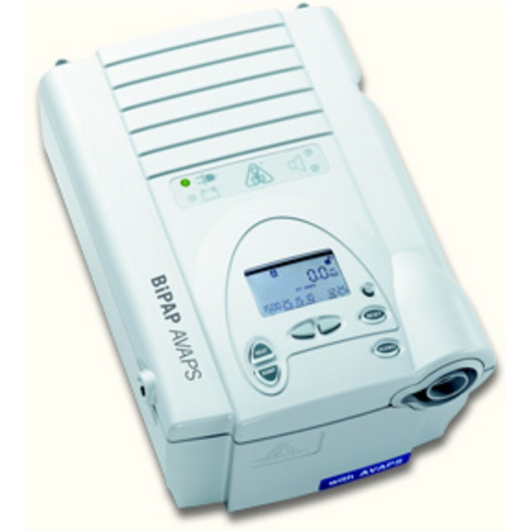
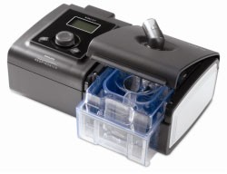
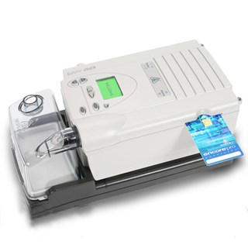

Slide 7
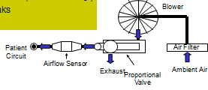
Circuit

Slide 8
Any mode of mechanical ventilation has three essential components :
1- The control variable (here >>>> preset volume)

Slide 9
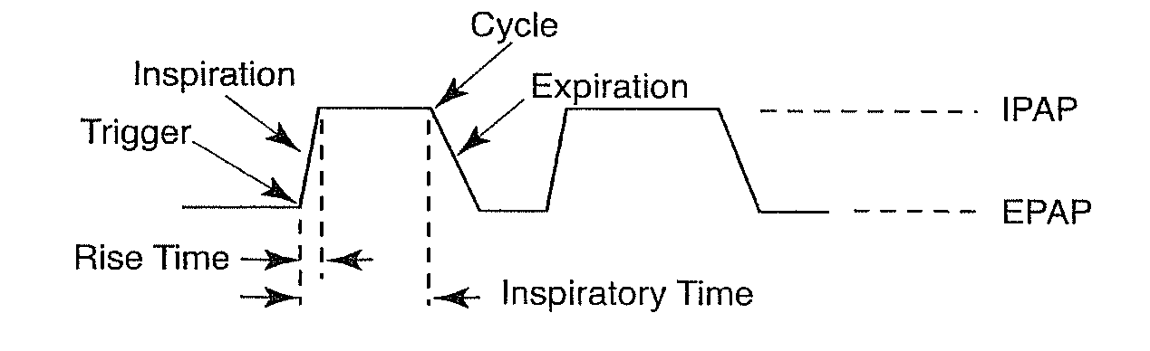
2- The breath sequence

Slide 10
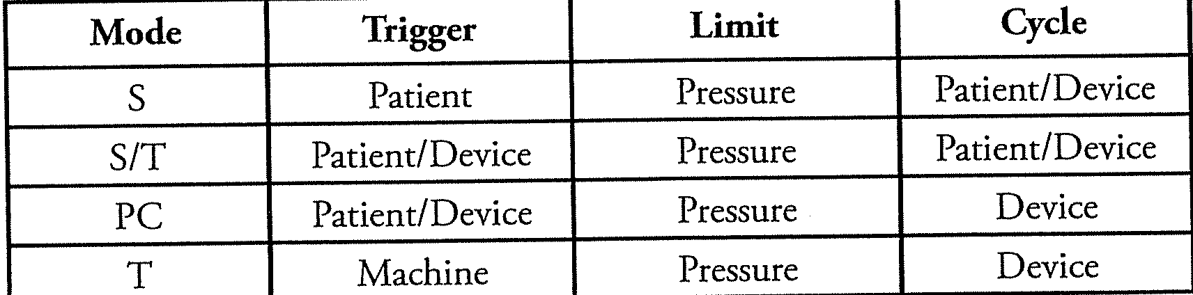
2- The breath sequence

Slide 11
AVAPS Ventilation Modes
S mode
IPAP
EPAP
S/T mode
IPAP
EPAP
RR
Ti
P/C mode
IPAP
EPAP
RR
Ti
T mode
IPAP
EPAP
RR
Ti
Spontaneous breaths
Spontaneous breaths with back up respiratory rate
Ti fixed for every breath
Each breath is controlled
Patient can trigger to inspiration

Slide 12
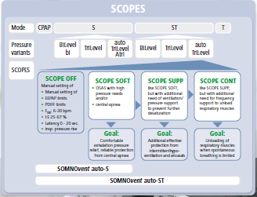
3- The target scheme

Slide 13
Modes supported by AVAPS

Slide 14


Slide 15

Who benefits from AVAPS technology?

Slide 16
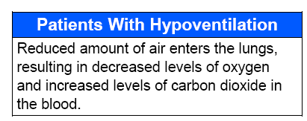
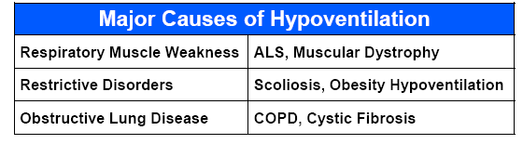

Slide 17
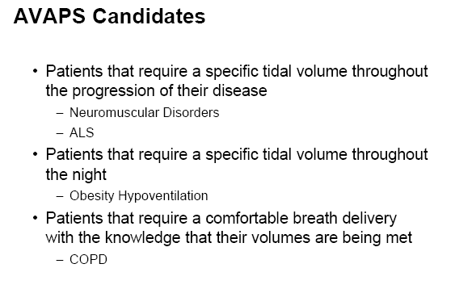

Slide 18
This device can be used in:
Hospital
(Acute setting)
or
Home
(Chronic setting)

Slide 19
The BiPAP AVAPS device is intended to provide noninvasive ventilation for:
pediatric patients ≥ 7 years or ≥ 18.2 kg
adult patients

Slide 20
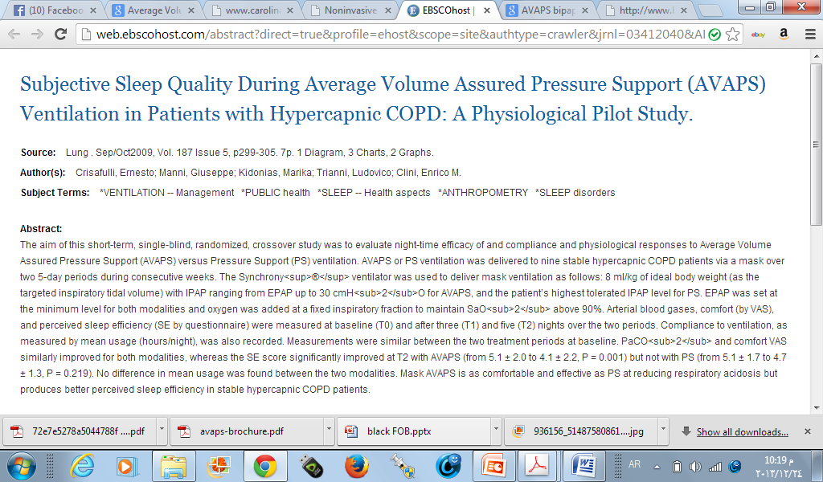
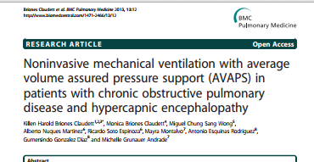
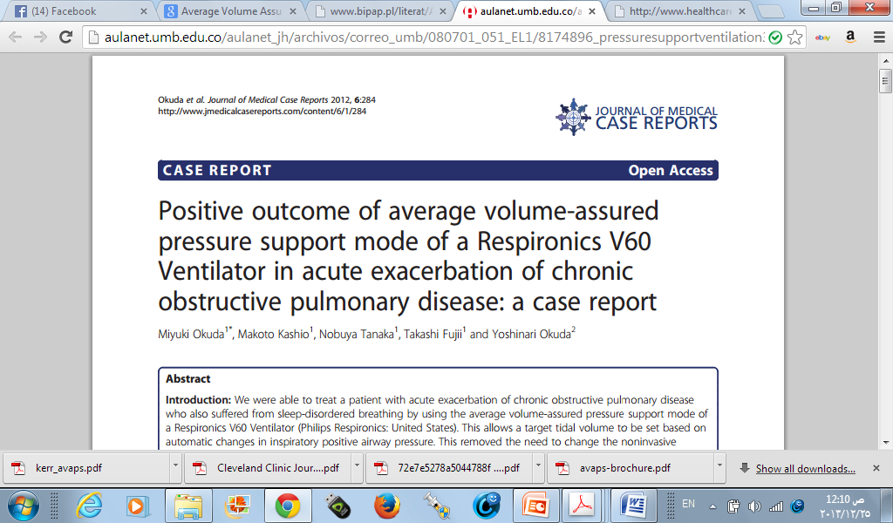


Slide 21


Slide 22
The exclusive AVAPS algorithm automatically
adjusts inspiratory pressure support
to meet the changes in patient’s needs aiming to maintain the target tidal volume after evaluation of eTV over several breathes

Slide 24

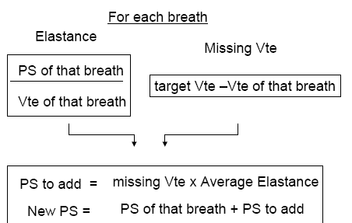

Slide 25
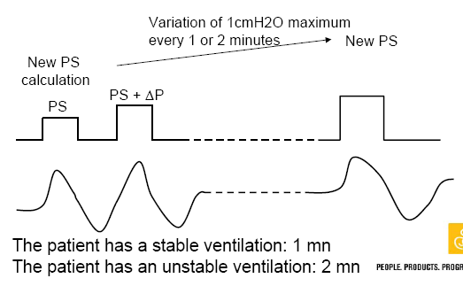

Slide 26
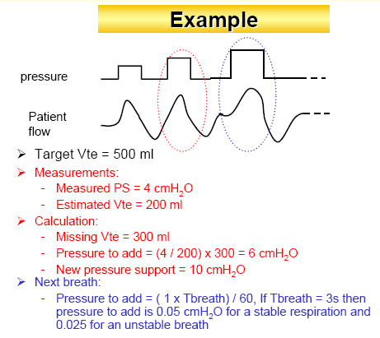

Slide 27
Advantages
1- Increase safety by guaranteeing a minimum ventilation by providing greater stability of tidal volume (Vt) in the face of:
    varying patient effort
    chest wall compliance
    airway resistance
No guessing if the patient is getting their prescribed therapy
So it can adapt to disease progression by adjusting therapy to meet patients changing needs
.

Slide 28
2- Maintains optimal patient comfort by using the minimum pressure to achieve the target tidal volume
3- Simplifies the titration process as no trials and errors to get the desired tidal volume
4- Alarms to indicate that tidal volume is not being maintained.

Slide 29
Disadvantages
1- Treatment of periodic breathing requires a variable breath by breath response system so the patients PaCO2 stabilizes quickly to prevents overshooting or undershooting of the PaCO2 , AVAPS does not respond fast enough so event will be over before reaching needed pressure
2- EPAP fixed value less comfortable to patients during expiration
3- IPAP max 25-30 cmH2O

Slide 30
Contraindications
1-severe respiratory failure without a spontaneous respiratory drive.
2-If any of the following conditions exist:
  • Inability to maintain an open airway or adequately clear secretions
  • At risk for aspiration of gastric contents
  • Diagnosed with acute sinusitis or otitis media
  • Allergy or hypersensitivity to the mask materials
  • Epistaxis, causing pulmonary aspiration of blood
  • Hypotension

Slide 31


Slide 32
How to set

Slide 33
Glossary

Slide 35
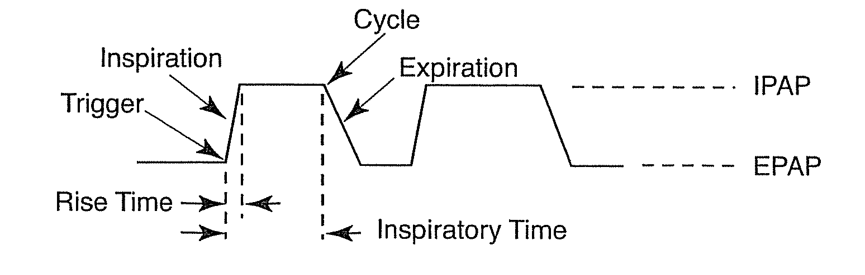
Rise time

Slide 36
Bi-Flex comfort feature

Slide 37
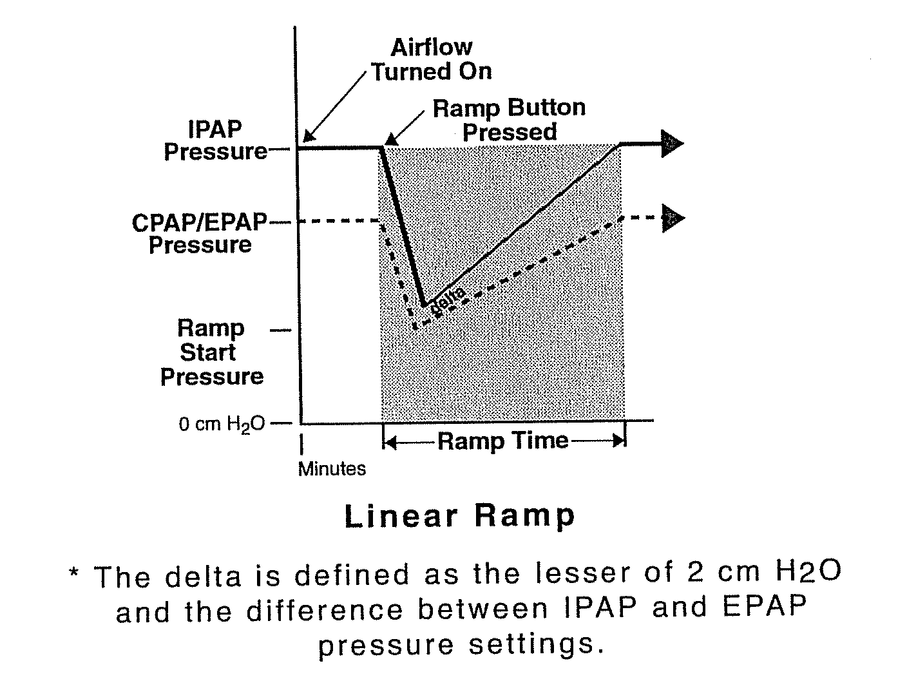
Ramp
4

Slide 38
Back up rate

Slide 39
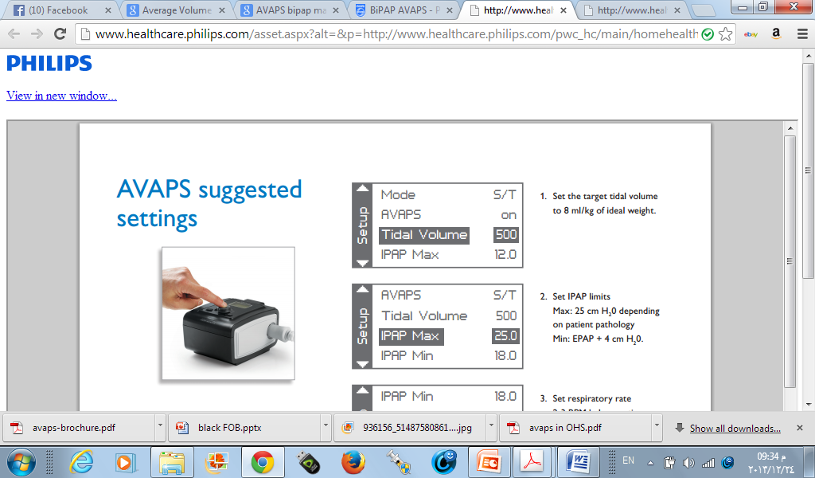
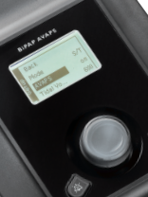

Slide 40
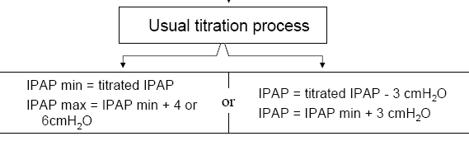
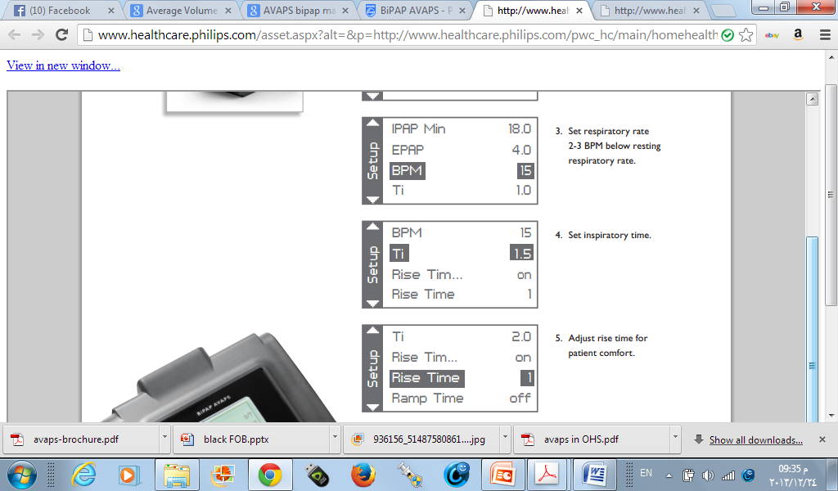
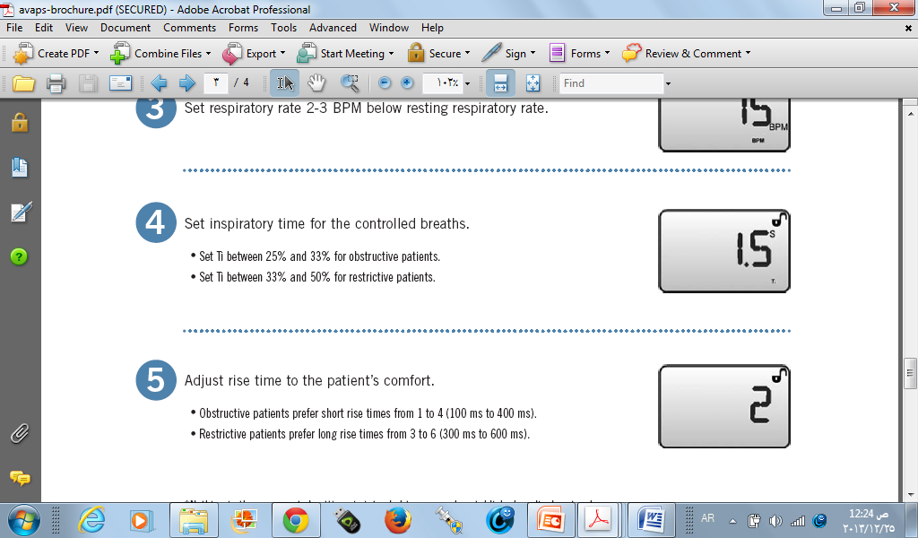

Slide 42
Ideal body weight
Estimated ideal body weight in (kg)
Males: IBW = 50 kg + 2.3 kg for each inch over 5 feet (feet=30 cm)
Females: IBW = 45.5 kg + 2.3 kg for each inch over 5 feet.
Estimated adjusted body weight (kg)
If the actual body weight is greater than 30% of the calculated IBW, calculate the adjusted body weight
ABW = IBW + 0.4(actual weight - IBW)

Slide 43
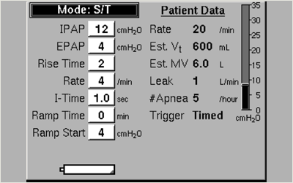

Slide 44
Alarms
Disconnection: OFF, 15, 60 sec.
  High flow rate and small pressure
Low minute Ventilation: from 0 to 99 LPM
Apnea alarm: OFF, 10, 20, 30 sec.
Low tidal Volume: OFF (0) / ON (1)
  When the target tidal volume is not reached whereas the IPAP is at the set IPAP max level

Slide 45
Accessories

Slide 46
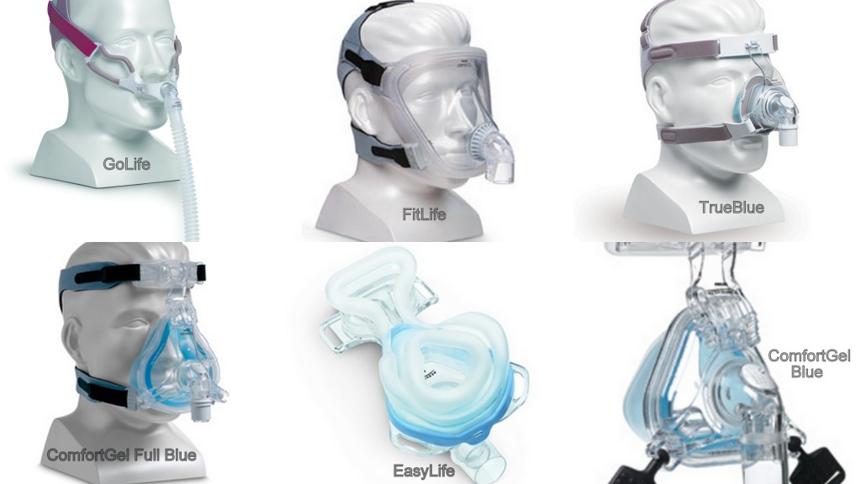

Slide 47
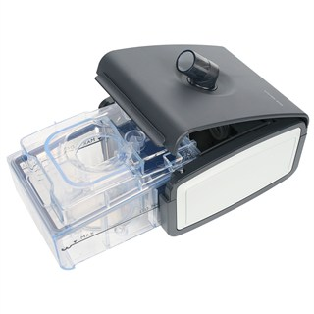

Slide 48
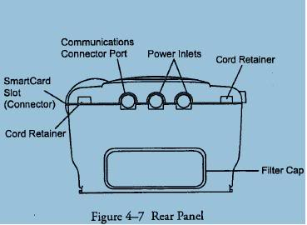
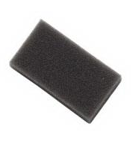
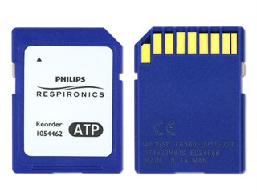

Slide 49
Battery Pack
for Portable Use & Increased Safety
Universal battery charger 100/240V for ease of travel
7hrs autonomy at IPAP 20 / EPAP 4 cmH₂O and 12 BPM
Notes:
This battery can be connected to any Respironics BiPAP : BiPAP Synchrony, BiPAP Harmony and BiPAP Pro.
The new battery pack will then perfectly suit for portable use with active lifestyle patients (i.e. camping, etc.) and mobile patients on wheelchair, and for safety consideration with patients that have the need for backup power.
Main features:
- Sealed Lead Acid Battery combination is 12v 14.4AH.
- Packaged together with Charger and DC cable in 1 carrying case weighing approximately 13.5lbs/6.2Kg.
- Overall dimensions of the Carrying Case are 8 ½” x 7” x 7”: 21 x 18 x 18 cm
- Battery Charger has universal input of 100-240VAC with LED charging status. Also comes with 4 different plugs to work virtually throughout the world.
- Battery Charger recharges current battery configuration in ~10 hours or less, depending on charge status of batteries
Run Time on common RI units:
- MPAP at 12cmH20: ~26hours
- MPAP at 20/4cmH20 and 12BPM: ~16 hours
- BiPAP Pro 2 at 20/4cmH20 and 12BPM: ~7 hours
BiPAP Harmony or BiPAP Synchrony at 20/4cmH20 and 12BPM: ~7 hours

Slide 50

Take home message

Slide 51

1- BiPAP-AVAPS assure targeted tidal volume
2- useful in hypoventilated patient
3- not suitable for CSR

Slide 52



Slide 53

